Slide 1
Chapter 25 Gauss’ Law

Slide 2
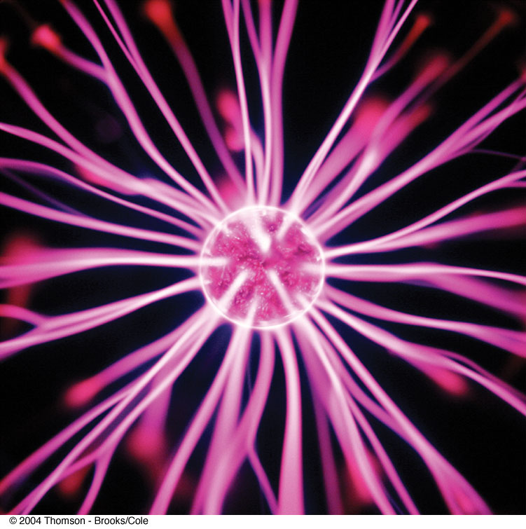

Slide 3
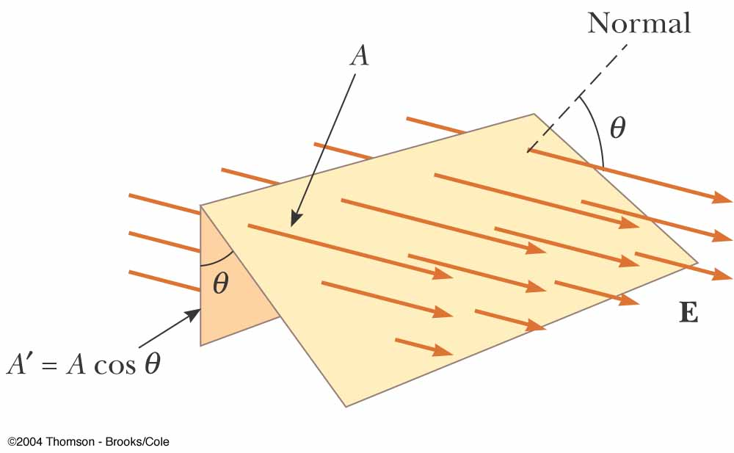
A new (mathematical) look at Faraday’s electric field lines

Slide 4
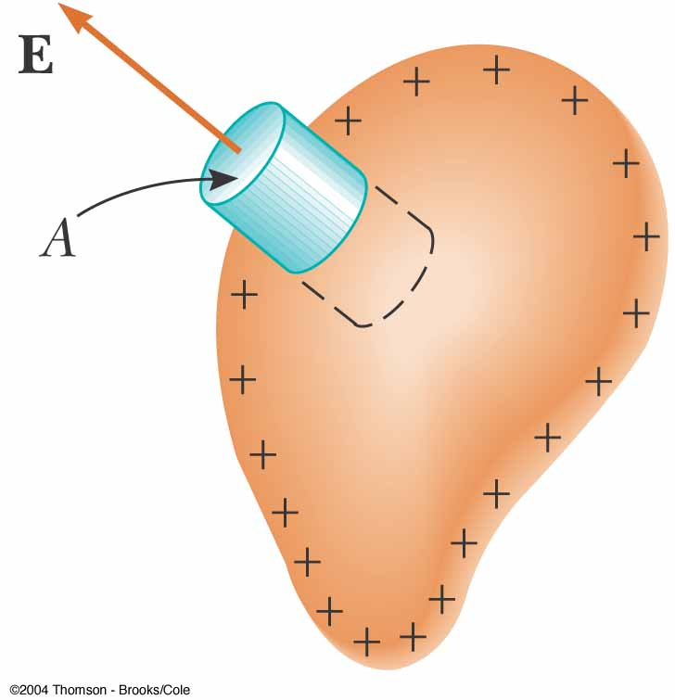
A charged isolated conductor
Electric field near the outer surface of a conductor:

Slide 5
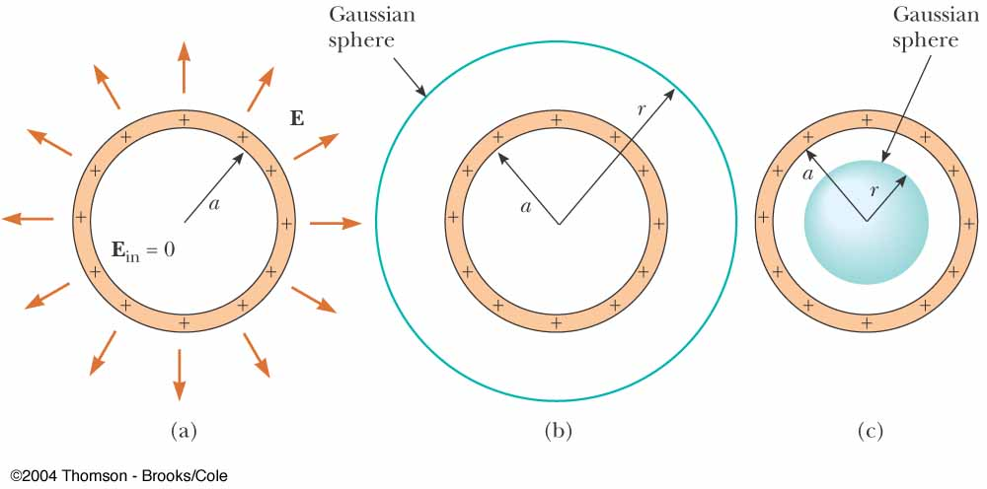
Applications of Gauss’ law

Slide 6
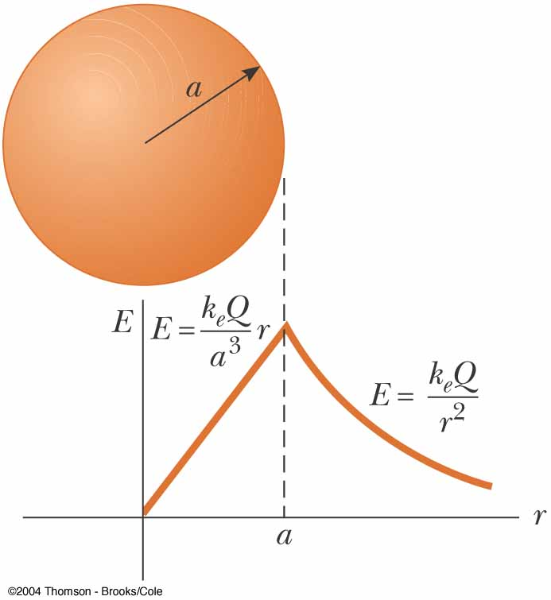
A uniformly charged sphere

Slide 7
Problem solving guide for Gauss’ law
Use the symmetry of the charge distribution to determine the pattern of the field lines.
Choose a Gaussian surface for which E is either parallel to or perpendicular to dA.
If E is parallel to dA, then the magnitude of E should be constant over this part of the surface. The integral then reduces to a sum over area elements.

Slide 8
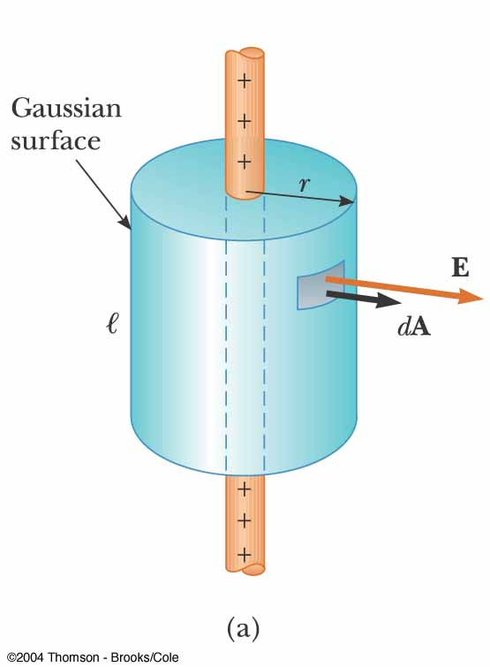
Applications of Gauss’ law

Slide 9
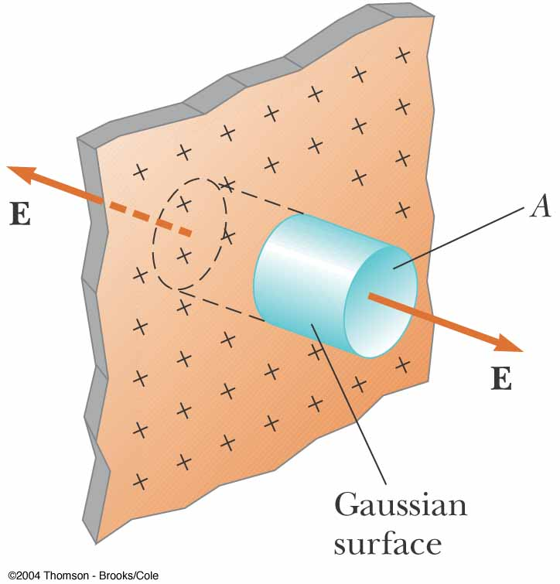
Applications of Gauss’ law

Slide 10
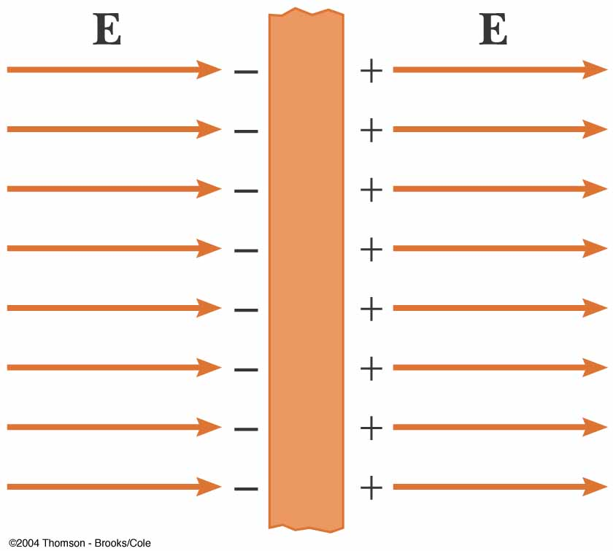
Applications of Gauss’ law

Slide 11
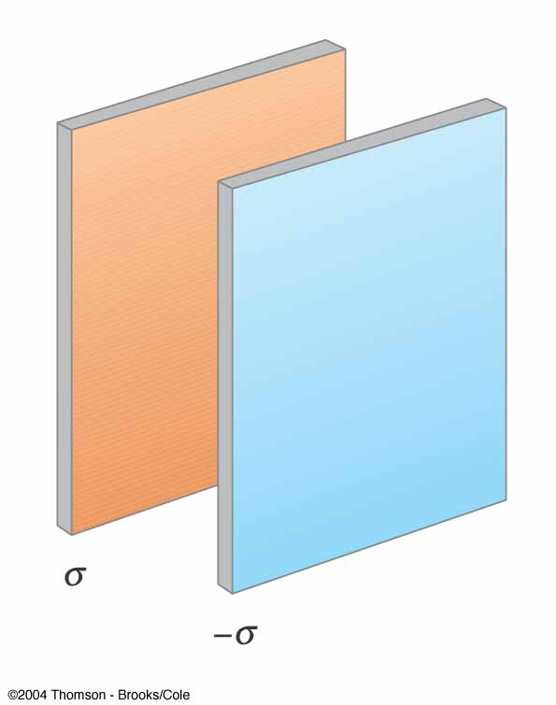
Applications of Gauss’ law

Slide 12
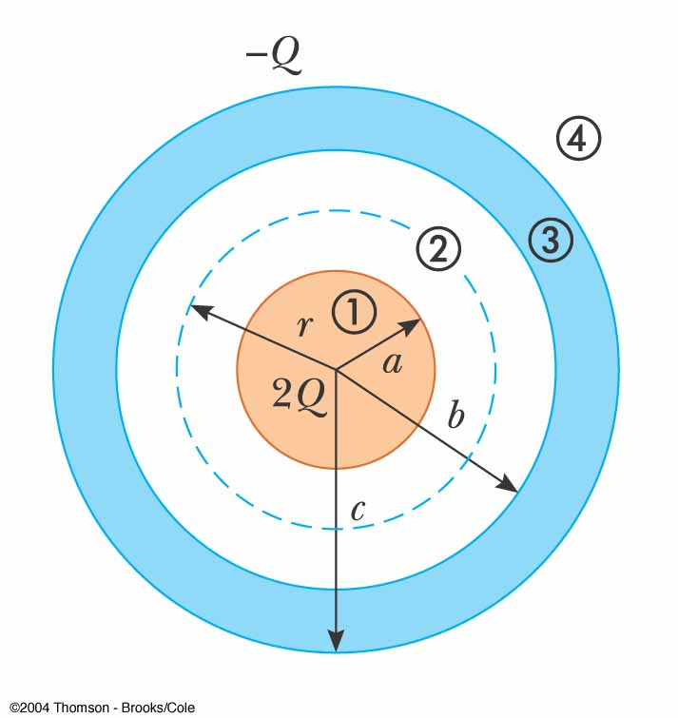
Applications of Gauss’ law

Slide 13
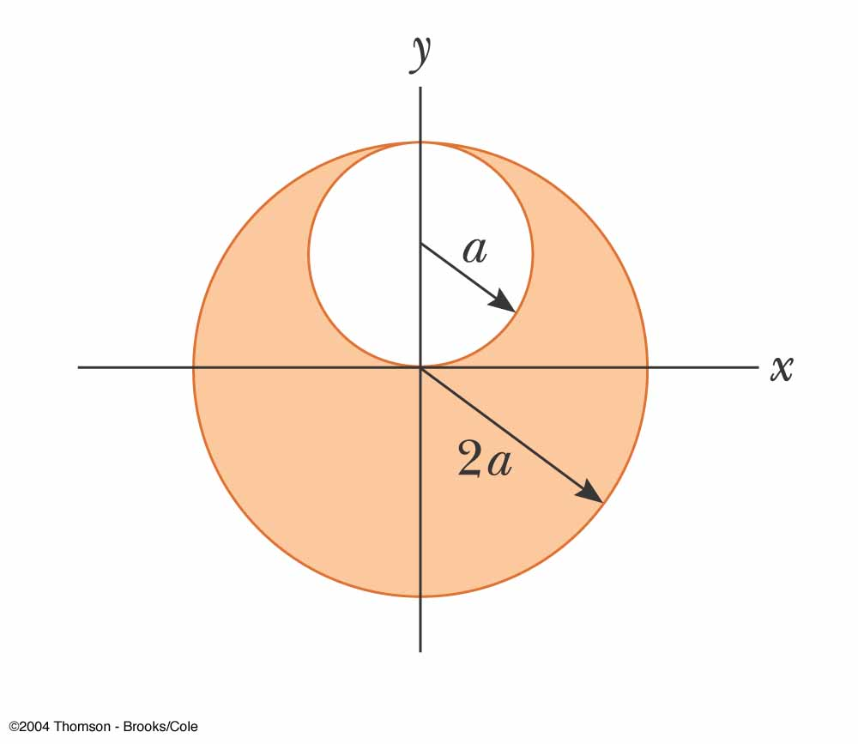
Applications of Gauss’ law

Slide 14
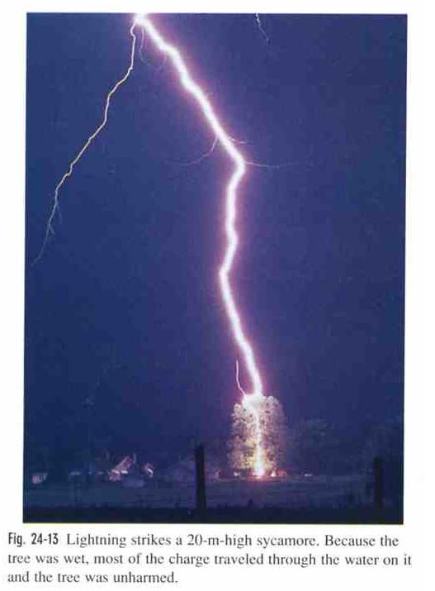
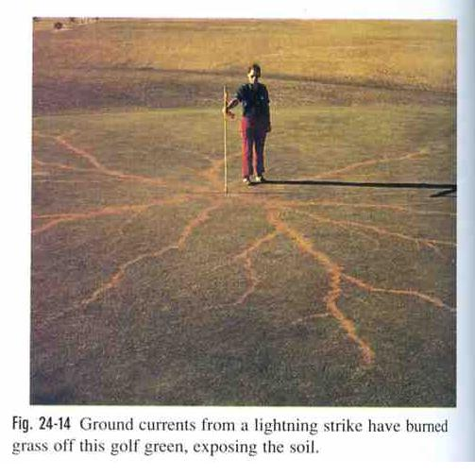
Applications of Gauss’ law
Given that the linear charge density of a charged air column is -10⁻³ C/m, find the radius of the column.

Slide 15
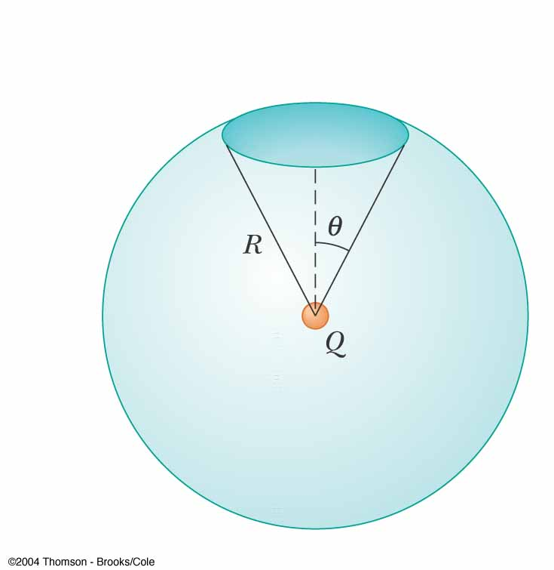
Applications of Gauss’ law

